Slide 1
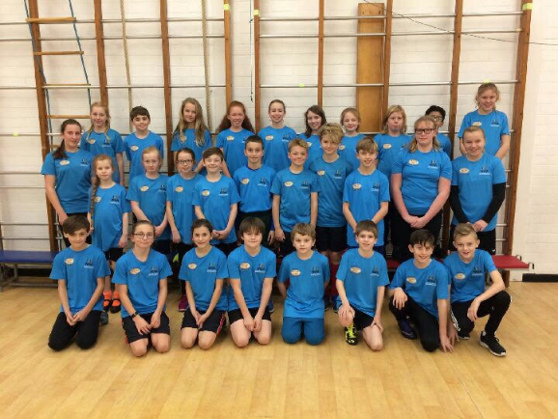
WSSA Legacy Leaders 2019/20 12th September 2019 4pm -5.30pm Chesswood Junior School

Slide 2
Why are you here ?
To share ideas to help encourage those who are less active to participate in PE and sport
To improve your Leadership skills so you have the confidence and knowledge to lead competitions and festivals in your own school.

Slide 3
Activities you can help with
Mo Farah Fun Run
Year 1/2 Indoor athletics

Slide 4
And some more …
KS 2 Boccia competition
New Age Kurling

Slide 5
Year 2 Legacy Games
Inter House Cross Country

Slide 6
Overall Plan
You will be invited to attend sessions during the year on:
12th September – Team Building and Raising Activity levels
7th November – Competition organisation
5th December – Planning and organising a KS1 Multi –skills Festival
12th December – Delivering Multi -skills Ks 1Festival venue tbc’d)
12th March – Inclusion activities
2nd April - Delivering a KS1 inclusion festival (venue tbc’d)

Slide 7
Today
Get to know other Legacy Leaders by completing Team challenges
Take leadership opportunities within your group and as part of the Legacy Team
Discuss different ways of raising participation in your school
Gain enough knowledge and confidence to improve participation in your own school.

Slide 8
Team building challenges!!
Bench
Blanket
Bucket
Hoops

Slide 9
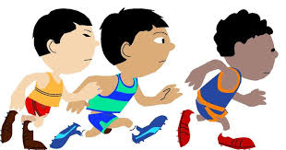
Raising Activity Levels and beating your personal best.
Discuss in your groups how you could
raise participation
increase physical activity
beat your personal best
in school ?

Slide 10
Playground Games /activities
Rock, paper, scissors
Circle Tag
Passing the hoop around the circle
Beat the ball
Under and Over
French Cricket

Slide 11
What next ?
Talk to your teachers about setting up some playground games/activities/personal best challenges in your school.
Take some photographs of these activities and bring them to the next Legacy Leaders session on the 7th November

Slide 12
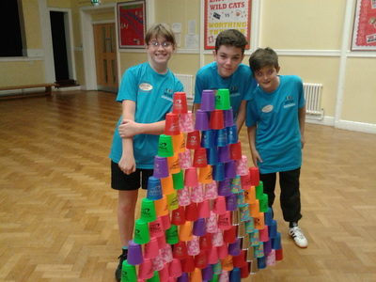
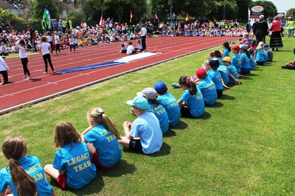
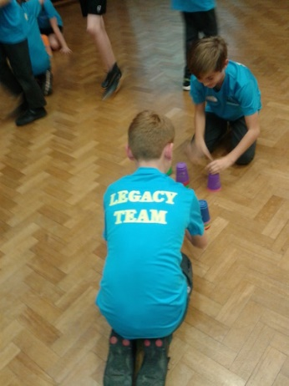
Finally …
Enjoy being a
Legacy Leader!!

